Slide 1
CS 252 Database Management Systems
Jan – May 2020
IV Semester
* Use the slides for reference only. Refer the text book for details.

Slide 2
Relational Model Concepts
The relational Model of Data is based on the concept of a Relation
The strength of the relational approach to data management comes from the formal foundation provided by the theory of relations
A Relation is a mathematical concept based on the ideas of sets
The model was first proposed by Dr. E.F. Codd of IBM Research in 1970 in the following paper:
"A Relational Model for Large Shared Data Banks," Communications of the ACM, June 1970

Slide 3
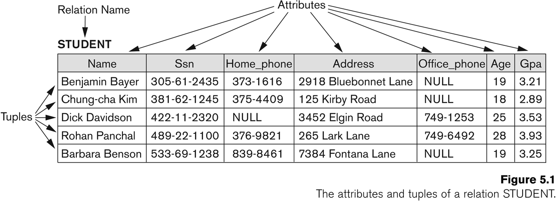
Example of a Relation

Slide 4
Informal Definitions
Key of a Relation:
Each row has a value of a data item (or set of items) that uniquely identifies that row in the table
Called the key
In the STUDENT table, SSN is the key
Sometimes row-ids or sequential numbers are assigned as keys to identify the rows in a table
Called artificial key or surrogate key

Slide 5
Formal Definitions - Schema
The Schema (or description) of a Relation:
Denoted by R(A1, A2, .....An)
R is the name of the relation
The attributes of the relation are A1, A2, ..., An
Example:
CUSTOMER (Cust-id, Cust-name, Address, Phone#)
CUSTOMER is the relation name
Defined over the four attributes: Cust-id, Cust-name, Address, Phone#
Each attribute has a domain or a set of valid values.
For example, the domain of Cust-id is 6 digit numbers.

Slide 6
Formal Definitions - Tuple
A tuple is an ordered set of values (enclosed in angled brackets ‘< … >’)
Each value is derived from an appropriate domain.
A row in the CUSTOMER relation would consist of four values, for example:
<632895, "John Smith", "101 Main St. Atlanta, GA 30332", "(404) 894-2000">
A relation is a set of such tuples (rows)

Slide 7
Formal Definitions - Domain
A domain has a logical definition:
Example: “USA_phone_numbers” are the set of 10 digit phone numbers valid in the U.S.
A domain also has a data-type or a format defined for it.
The USA_phone_numbers may have a format: (ddd)ddd-dddd where each d is a decimal digit.
Dates have various formats such as year, month, date formatted as yyyy-mm-dd, or as dd mm,yyyy etc.
The attribute name designates the role played by a domain in a relation:
Used to interpret the meaning of the data elements corresponding to that attribute
Example: The domain Date may be used to define two attributes named “Invoice-date” and “Payment-date” with different meanings

Slide 8
Formal Definitions - State
The relation state is a subset of the Cartesian product of the domains of its attributes
each domain contains the set of all possible values the attribute can take.
Example: attribute Cust-name is defined over the domain of character strings of maximum length 25
dom(Cust-name) is varchar(25)
The role these strings play in the CUSTOMER relation is that of the name of a customer.

Slide 9
Formal Definitions - Summary
Formally,
Given R(A1, A2, .........., An)
r(R) ⊂ dom (A1) X dom (A2) X ....X dom(An)
R(A1, A2, …, An) is the schema of the relation
R is the name of the relation
A1, A2, …, An are the attributes of the relation
r(R): a specific state (or "value" or “population”) of relation R – this is a set of tuples (rows)
r(R) = {t1, t2, …, tn} where each ti is an n-tuple
ti = <v1, v2, …, vn> where each vj element-of dom(Aj)

Slide 10
Formal Definitions - Example
Let R(A1, A2) be a relation schema:
Let dom(A1) = {0,1}
Let dom(A2) = {a,b,c}
Then: dom(A1) X dom(A2) is all possible combinations:
{<0,a> , <0,b> , <0,c>, <1,a>, <1,b>, <1,c> }
The relation state r(R) ⊂ dom(A1) X dom(A2)
For example: r(R) could be {<0,a> , <0,b> , <1,c> }
this is one possible state (or “population” or “extension”) r of the relation R, defined over A1 and A2.
It has three 2-tuples: <0,a> , <0,b> , <1,c>

Slide 11
Definition Summary
Informal Terms |  | Formal Terms
Table |  | Relation
Column Header |  | Attribute
All possible Column Values |  | Domain
Row |  | Tuple
Table Definition |  | Schema of a Relation
Populated Table |  | State of the Relation

Slide 12
Example – A relation STUDENT

Slide 13
Characteristics Of Relations
Ordering of tuples in a relation r(R):
The tuples are not considered to be ordered, even though they appear to be in the tabular form.
Ordering of attributes in a relation schema R (and of values within each tuple):
We will consider the attributes in R(A1, A2, ..., An) and the values in t=<v1, v2, ..., vn> to be ordered .
(However, a more general alternative definition of relation does not require this ordering. It includes both the name and the value for each of the attributes ).
Example: t= { <name, “John” >, <SSN, 123456789> }
This representation may be called as “self-describing”.

Slide 14
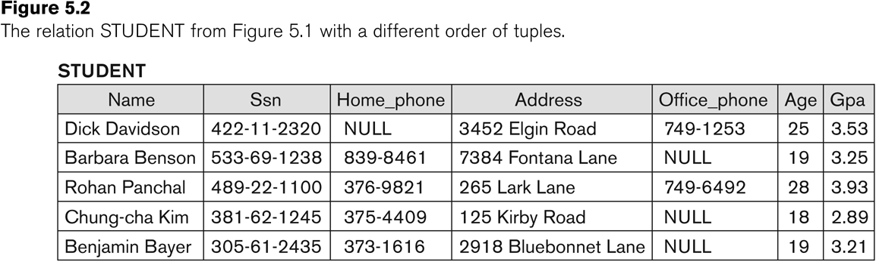
Same state as previous Figure (but with different order of tuples)

Slide 15
Characteristics Of Relations
Values in a tuple:
All values are considered atomic (indivisible).
Each value in a tuple must be from the domain of the attribute for that column
If tuple t = <v1, v2, …, vn> is a tuple (row) in the relation state r of R(A1, A2, …, An)
Then each vi must be a value from dom(Ai)
A special null value is used to represent values that are unknown or not available or inapplicable in certain tuples.

Slide 16
Characteristics Of Relations
Notation:
We refer to component values of a tuple t by:
t[Ai] or t.Ai
This is the value vi of attribute Ai for tuple t
Similarly, t[Au, Av, ..., Aw] refers to the subtuple of t containing the values of attributes Au, Av, ..., Aw, respectively in t

